Slide 1
Introduction to Digital Modulation
Digital modulation
Is the transmittal of digitally modulated analog signals between two or more points in a communications system.
Can be propagated through Earth’s atmosphere and used in wireless communication system - digital radio.
Offer several outstanding advantages over traditional analog system.
Ease of processing
Ease of multiplexing
Noise immunity

Slide 2
Introduction to Digital Modulation
Applications:
Low speed voice band data comm. modems
High speed data transmission systems
Digital microwave & satellite comm. systems
PCS (personal communication systems) telephone

Slide 3
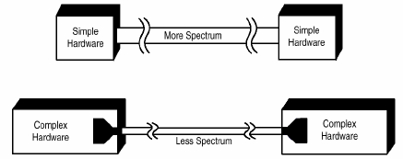
Introduction to Digital Modulation
Why digital modulation?
The modulation of digital signals with analogue carriers allows an improvement in signal to noise ratio as compared to analogue modulating schemes.

Slide 4
Introduction to Digital Modulation
Important Criteria
1. High spectral efficiency
2. High power efficiency
3. Robust to multipath
4. Low cost and ease of implementation
Low carrier-to-co channel
interference ratio
6. Low out-of-band radiation

Slide 5
Introduction to Digital Modulation
7. Constant or near constant envelop
8. Bandwidth Efficiency
Ability to accommodate data within a limited bandwidth
Tradeoff between data rate and pulse width
9. Power Efficiency
To preserve the fidelity of the digital message at low power levels.
Can increase noise immunity by increasing signal power

Slide 6
PULSE MODULATION

Slide 7
Introduction to Pulse Modulation
Pulse modulation includes many different methods of converting information into pulse form for transferring pulses from a source to a destination.
Divided into two categories;
1. Analog Pulse Modulation (APM)
2. Digital Pulse Modulation (DPM)

Slide 8
PULSE MODULATION
Sampling analog information signal
Converting samples into discrete pulses
Transport the pulses over physical transmission medium.
Four (4) Methods
1. PAM
2. PWM
3. PPM
4. PCM
Analog Pulse Modulation
Digital Pulse Modulation

Slide 9
PULSE MODULATION :Sampling
What is sampling?
Sampling is the process of taking periodic sample of the waveform to be transmitted.
“the more samples that are taken, the more final outcome looks like the original wave.
However if fewer samples are taken, then other kinds information could be transmitted.”

Slide 10
PULSE MODULATION :Sampling
Sampling theorem (Nyquist’s theorem)
- is used to determine minimum sampling rate for any signal so that the signal will be correctly restored at the receiver.
Nyquist’s theorem states that,
“The original information signal can be reconstructed at the receiver with minimal distortion if the sampling rate in the pulse modulation system is equal to or greater than twice the maximum information signal frequency”

Slide 11
PULSE MODULATION :Sampling
sampling frequency
_{fs=sampling frequency and}
fm(max) = maximun frequency of the modulating signal.

Slide 12
PULSE MODULATION :Sampling
Basic condition of sampling process
1) sampling at Fs =2fm(max)
fs 2fs
figure 4.1 :
Frequency spectrum of modulating signal when sampled at fs=2fm(max)
V( Volts)

Slide 13
PULSE MODULATION :Sampling
When the modulating is sampled at a minimum sampling frequency, the frequency spectrum is as shown in figure 4.1.
In practice it is difficult to design a low pass filter, in order to restore the original modulating signal

Slide 14
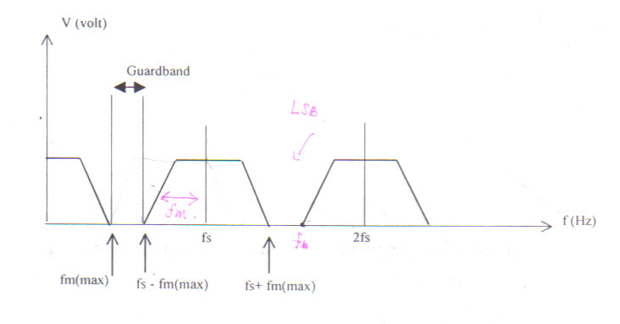
PULSE MODULATION :Sampling
2) sampling at fs> 2fm(max)
This sampling rate creates a guard band between fm(max) and the lowest frequency component (fs-fm(max)) of the sampling harmonics.
Therefore a more practical LPF can be used to restore the modulating signal.
Figure 4.2 Sampling at fs> 2fm(max)

Slide 15
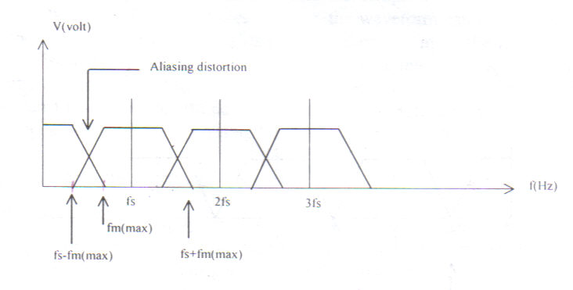
PULSE MODULATION :Sampling
Sampling at fs < 2fm(max)
When the sampling rate is less than the minimum value, distortion will occurs. This distortion is called aliasing.
Figure 4.3 Sampling at fs < 2fm(max)

Slide 16
Aliasing effect can be eliminated by using an anti-aliasing filter prior to sampling and using a sampling rate slightly higher than Nyquist rate (fs=2W).
Anti-aliasing
Filter
Sampler

Slide 17
ANALOG PULSE MODULATION (APM)
In APM, the carrier signal is in the form of pulse waveform, and the modulated signal is where one of the characteristic (either amplitude, width or position) is changed according to the modulating/audio signal
The three common techniques of APM are: Pulse Amplitude Modulation (PAM),
Pulse Width Modulation (PWM) and
Pulse Position Modulation (PPM). The waveforms of APM are shown in figure 4.4

Slide 18
Pulse Amplitude Modulation (PAM)
The simplest form of pulse modulation
The amplitude of a constant width, constant position pulse (carrier signal) is varied according to the amplitude of the modulating signal.
Basically the modulating signal is sampled by the digital train of pulses and the process is based upon the sampling theorem

Slide 19
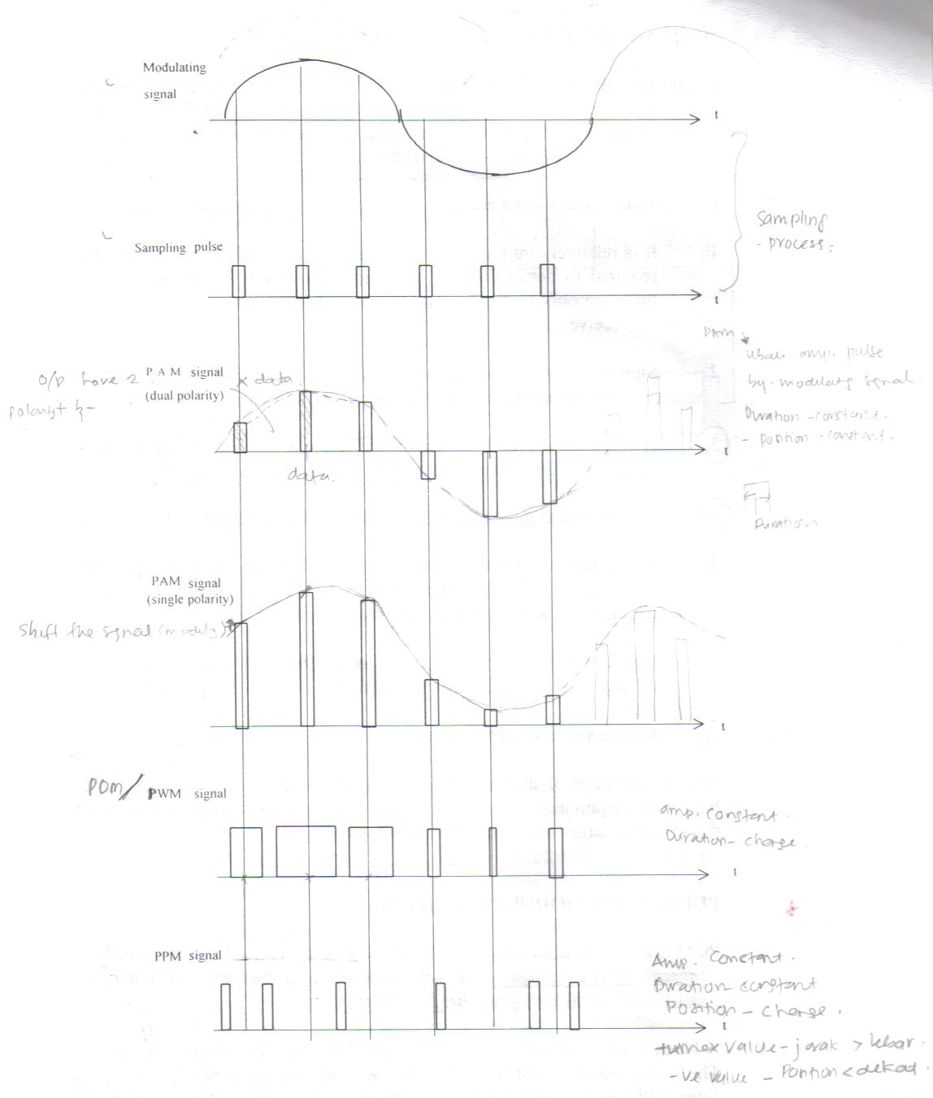
Fig.4.4 waveform for PAM,PWM & PPM

Slide 20
Pulse Width Modulation (PWM)
The technique of varying the width of the constant amplitude pulse proportional to the amplitude of the modulation signal.
Also known as Pulse Duration Modulation (FDM).
Either the leading edge, trailing edge or both may be varied by the modulating signal.

Slide 21
Pulse Width Modulation (PWM)
PWM gives better signal to noise performance than PAM.
PWM has advantage, when compared with PPM, that is its pulse are of varying width and therefore of varying power content. PWM still works if synchronization between transmitter and receiver fails, whereas PPM does not.

Slide 22
Pulse Position Modulation (PPM)
PPM is when the position of a constant-width and constant-amplitude pulse within prescribed time slot is varied according to the amplitude of the modulating signal.
PPM has the advantage of requiring constant transmitter power output, but the disavantage of depending on transmitter-receiver synchronization.
PPM has less noise due to amplitude changes, becaused the received pulses may be clipped at the receiver, thus removing amplitudeschanges caused by noise.

Slide 23
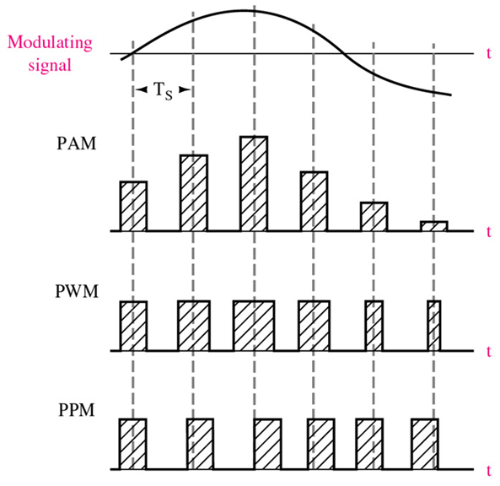
Pulse Amplitude Modulation (PAM)
Modulation in which the amplitude of pulses is varied in accordance with the modulating signal

Slide 24
Pulse Width Modulation (PWM) Modulation in which the duration of pulses is varied in accordance with the modulating signal

Slide 25
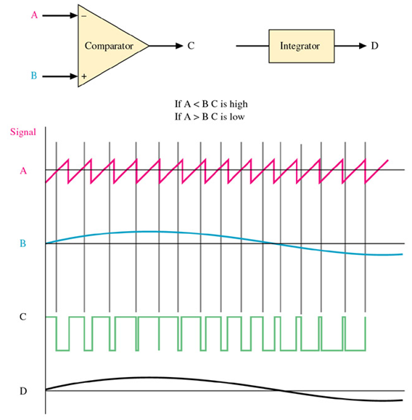
Pulse Width Modulation (PWM)

Slide 26
Pulse Position Modulation (PPM) Modulation in which the temporal positions of the pulses are varied in accordance with some characteristic of the modulating signal.

Slide 27
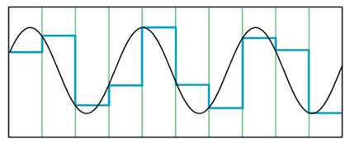
How to encode analog waveforms ?
(from analog sources into baseband digital signals)

Slide 28
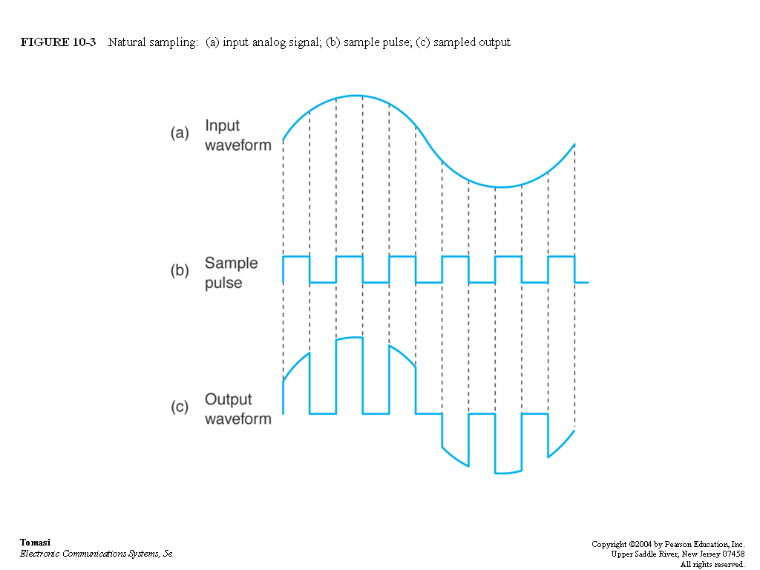
Natural Sampling

Slide 29
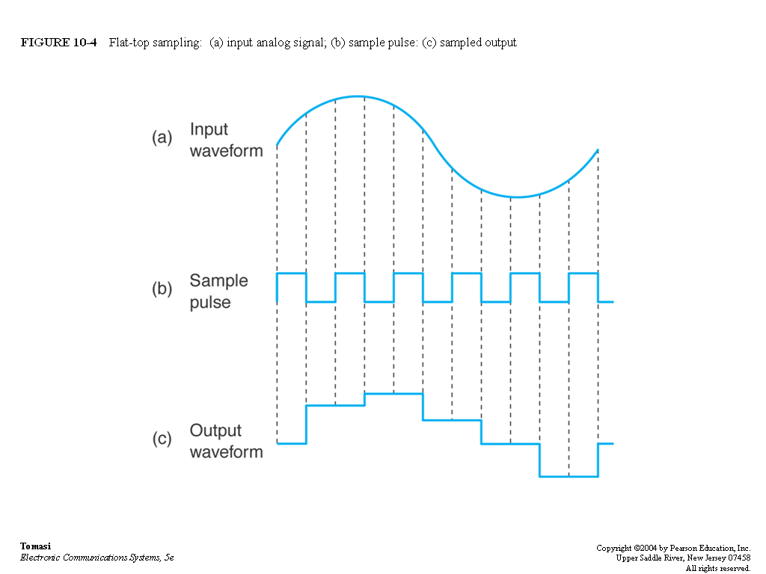
Flat-top Sampling

Slide 30
DIGITAL PULSE MODULATION (DPM) Pulse Code Modulation ( PCM )
PCM is a form of digital modulation where group of coded pulses are used to represent the analog signal. The analog signal is sampled and converted to a fixed length, serial binary number for transmission.
A block diagram of a PCM system is as shown in figure 4.5

Slide 31
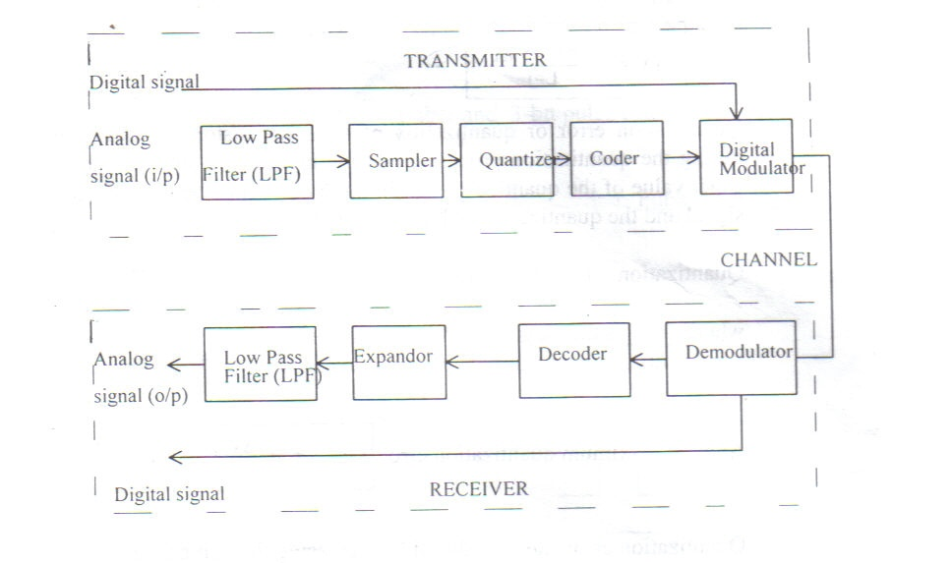
Fig.4.5 A block diagram of PCM system (single channel)

Slide 32
Principles of PCM
Three main process in PCM transmission are sampling, quantization and coding.
1. Sampling – is a process of taking samples of information signal at a rate of Nyquist’s sampling frequency.
2. Quantization – is a process of assigning the analog signal samples to a pre- determined discrete levels. The number of quantization levels ,L, depends on the number of bits per sample, n, used to code the signal. Where

Slide 33
Principles of PCM (…cont.)
The magnitude of the minimum stepsize of the quantization levels is called resolution,
It is equal in magnitude to the voltage of the least significant bit of the magnitude stepsize of the digital to analog converter (DAC). The resolution depends on the maximum voltage, Vmax, and the minimum voltage Vmin of the information signal, where

Slide 34
Principles of PCM (…cont.)
Quantization error or quantization noise is the distortion introduced during the quantization process when the modulating signal is not an exact value of the quantized level. It is the difference between original signal and the quantized signal magnitude that is :
Quantization error, Qe = |x(t)| - |q(t)|
Where |x(t)| is the magnitude of original signal
Where |q(t)| is the magnitude of quantized signal
The maximum quantization error,
Quantization error can be reduced by increasing the number of quantization level BUT this will increase the bandwidth required.

Slide 35
Principles of PCM (…cont.)
ENCODING
This is a process where each quantized sample is digitally encoded into n-bits codeword, where
n = number of bits/sample
L = number of quantization levels
Transmission bit rate (R) is the rate of information transmission (bits/sec).
It depends on the sampling frequency and the number of bit per sample used to encode the signal and is given by
Transmission bit rate
Transmission Bandwidth ;

Slide 36
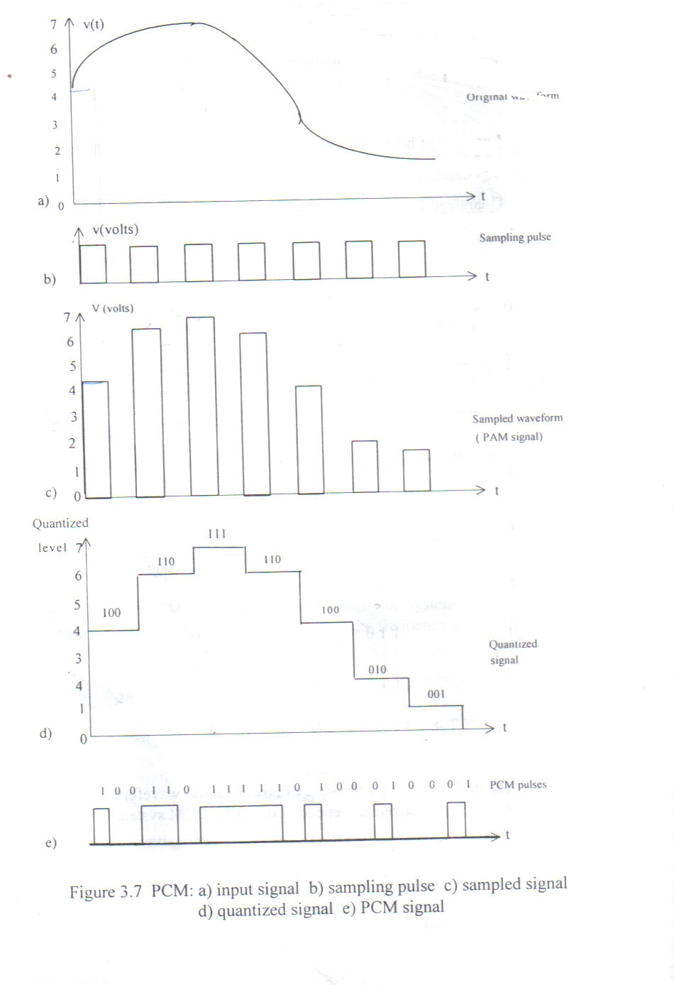
Fig.4.7 shows an example of how an audio waveform,v(t) is sampled,quantized and encoded into 3-bit PCM system

Slide 37
Examples
4.1 A sinusoidal input wave of 3kHz is to be sampled at the lowest rate for transmission as pulses. Calculate the minimum sampling frequency required, so that all components of the wave can be reconstructed at the receiver.
4.2 The PCM sampled are encoded into 4-bits system. If the minimum sampling rate used is 8kHz, calculate
the frequency of the information signal
the quantization level.
the transmission rate
The transmission bandwidth

